Slide 1
Lect -5
NETWORK MODELS (Protocol Layering)

Slide 2
What is Protocol ?
A protocol is based on set of rules and standards that provides communication service where the process is used to exchange the messages.

Slide 3
What is main function of protocol layering in networking?
The main function of Layering of protocols is that to provides well-defined interfaces between the layers, so that a change in one layer does not affect an adjacent layer.
Each layer needs to receive a set of services from the lower layer and to give the services to the upper layer. The modification done in any one layer will not affect the other layers.

Slide 4
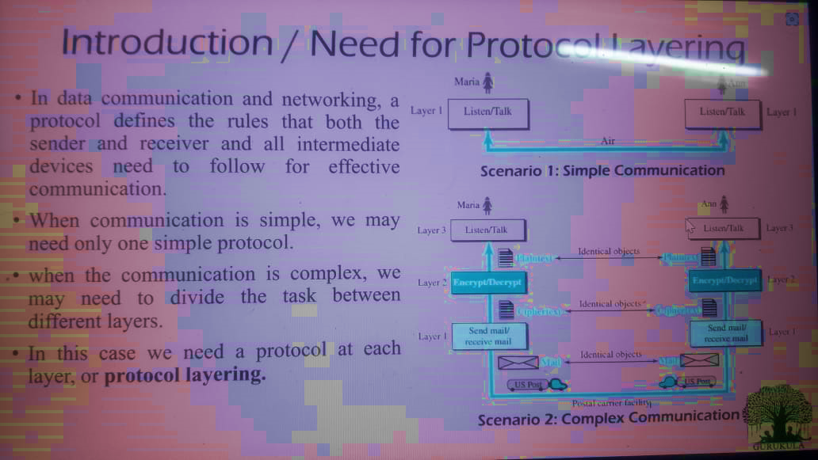
Why we need the protocol layering ?

Slide 5
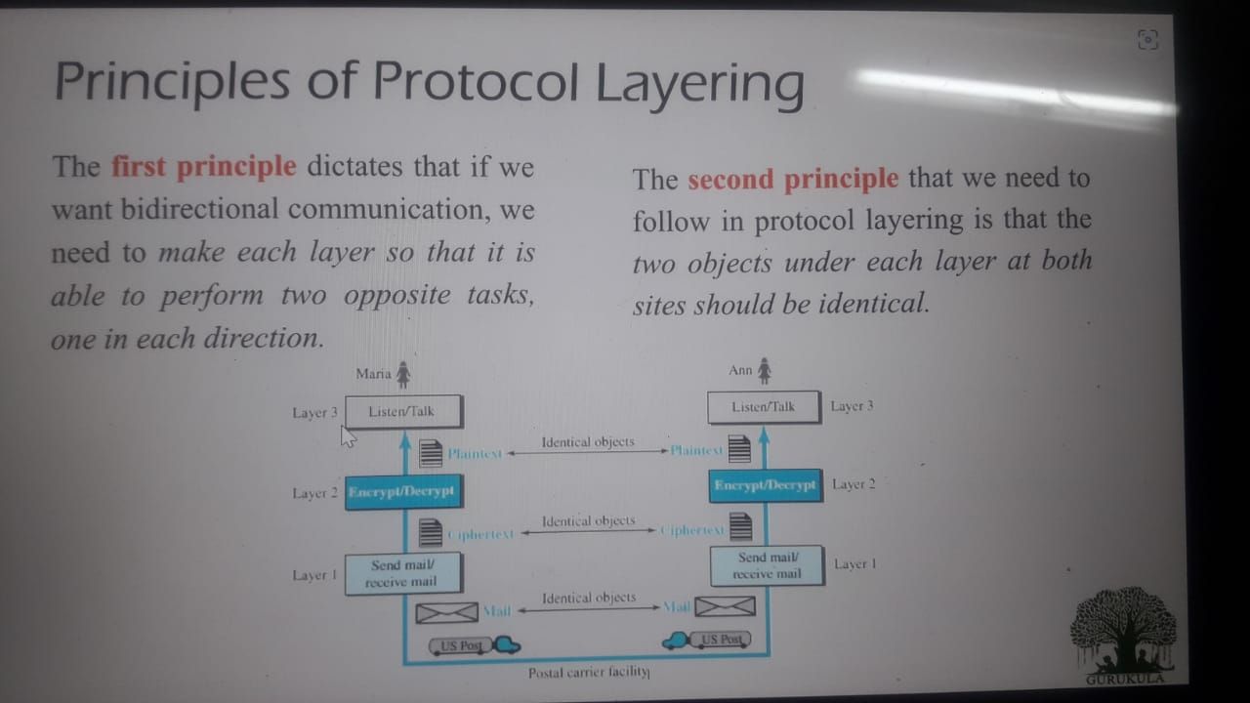
Principles of Protocol layering .

Slide 6
Network Software Protocol layer interface Hierarchies.

Slide 7
Design Issues for the Layers .
Addressing or naming.
• Error Control.
• Flow Control---Congestion.
• Statistical Multiplexing.
• Routing.
• Scalable.
• QoS---real time.
• Reliability.
• Security.

Slide 8
Why design the Computer Network Models ?
In the Early attempts it was very difficult to implement the software for such communication subsystems ( hardware and software ) which was complex were based on a single, complex, unstructured program with many interacting components.
The output of software was very difficult to test and change . To solve this problem, the ISO has developed a layered approach. In a layered approach, networking concept is divided into several layers, and each layer is assigned a particular task. Therefore, we can say that networking tasks depend upon the layers.

Slide 9
Reasons behind to design layered Architecture.
Layered Architecture
The main aim of the layered architecture is to divide the design into small pieces.
Each lower layer adds its services to the higher layer to provide a full set of services to manage communications and run the applications.
It provides clear interfaces, i.e., provides interaction between subsystems.
The main function of number of layers, is that the contents of each layer will vary from network to network. However, the purpose of each layer is to provide the service from lower to a higher layer and hiding the details from the layers of how the services are implemented.

Slide 10
The basic elements of layered architecture are -
The basic elements of layered architecture are services, protocols, and interfaces.
Service: It is a set of actions that a layer provides to the higher layer.
Protocol: It defines a set of rules that a layer uses to exchange the information with peer entity. These rules mainly concern about both the contents and order of the messages used.
Interface: It is a way through which the message is transferred from one layer to another layer.

Slide 11
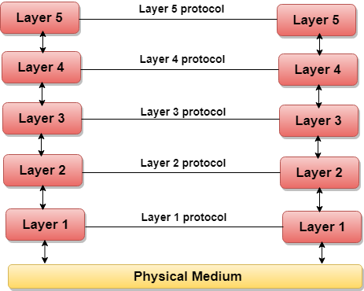
Example of the five-layered architecture.

Slide 12
How layered Architecture works .
layer 1 is the physical medium which is responsible for communication takes place.
In a layered architecture, complex tasks are divided into several small and manageable tasks.
The data is passed from the upper layer to lower layer through an interface. A Layered architecture provides a clean-cut interface so that minimum information is shared among different layers. It also ensures that the implementation of one layer can be easily replaced by another implementation.
A set of layers and protocols is known as network architecture.

Slide 13
What is osi Model ?
Osi model is also called a open systems interconnection (OSI) which consists of Seven layers that computer systems use to communicate over a network.
It was adopted by ISO for network communications and it was discovered in 1983 by representatives of the major computer and telecom companies .
OSI stands for open system interconnection is a reference model that describes how information from a software application in one computer moves through a physical medium to the software application in another computer.

Slide 14
Why OSI Model was designed ?.
OSI consists of seven layers, and each layer performs a particular network function.
OSI Model was developed by the international organization for standardization (iso) in 1984, and it is
now considered as an architectural model for the inter computer communications.
OSI model divides the whole task into seven smaller and manageable tasks. each layer is assigned a particular

Slide 15
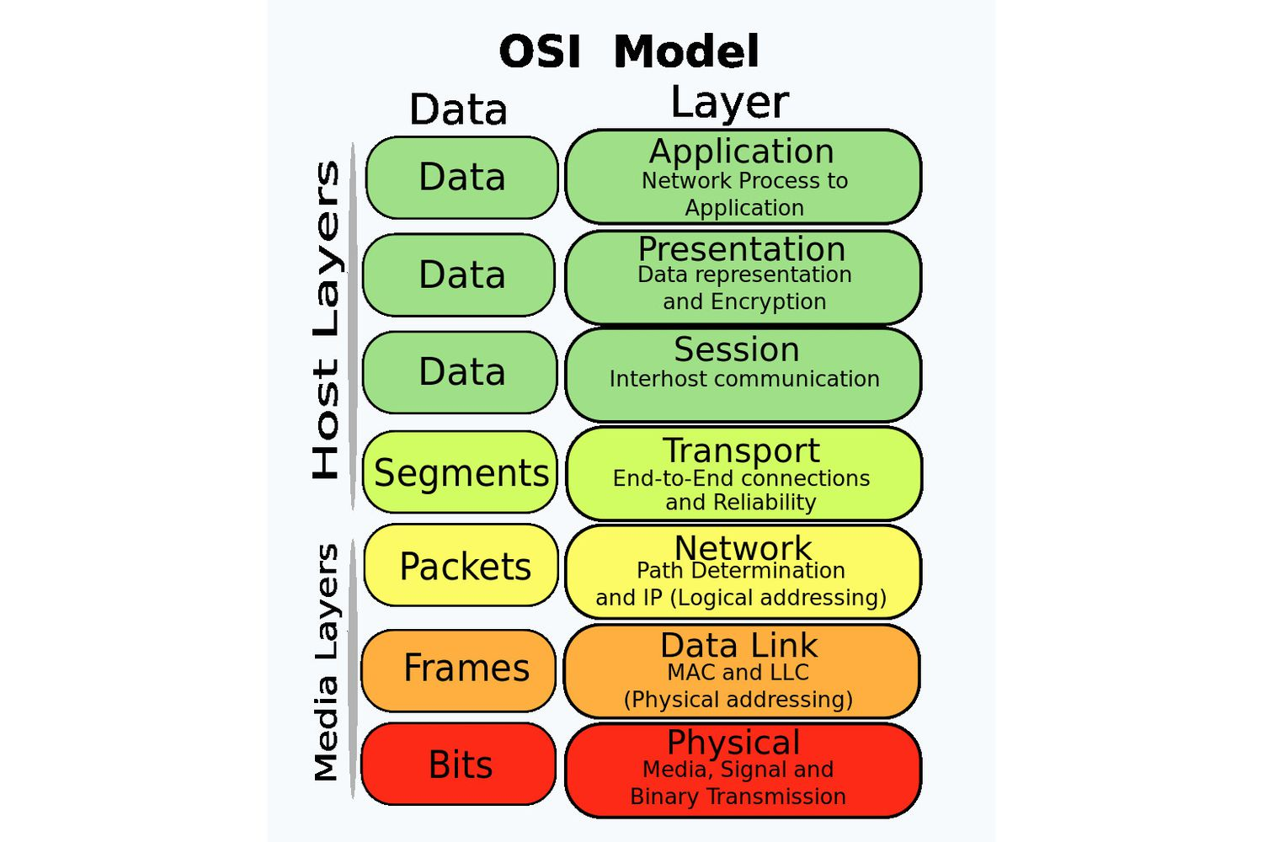
SEVEN LAYERS OF OSI MODEL .

Slide 16
The interaction between layers in the OSI model .

Slide 17
An exchange using the OSI model

Slide 18
Function of different layers in osi Model.
Layer 1- Physical Layer

Slide 19
Responsibility of physical layer.
The physical layer is the lowest layer of the OSI model.
The responsibility of physical layer is to controls the way unstructured, raw, bit -stream data is sent and received over a physical medium.
This layer is also responsible for electrical signaling, cabling and sending bits from one computer to another.
It also handles the transmission rate to improve the flow of data between a sender and receiver.

Slide 20
Functions perform by physical layer.
Type of transmission media
Representation of bits
Data rate
Synchronization of bits
Line Configuration
Topology
Transmission mode

Slide 21
Data link layer function -
The data link layer is responsible for moving frames from one hop (node) to the next.
Functions are performed by data link layer .
Framing
Physical addressing
Flow control
Error control
Access control

Slide 22
Data link layer takes service to physical layer.

Slide 23
Hop-to-hop delivery.

Slide 24
How the network layer works .

Slide 25
The main function of network layer is responsible for the delivery of individual packets from the source host to the destination host.

Slide 26
Network Layer Functions
Addressing - Maintains the address at the frame header of both source and destination and performs addressing to detect various devices in network.
Packeting: It is performed by Internet Protocol. The network layer converts the packets from its upper layer.

Slide 27
Function of network layer.
Routing: It is the most important functionality. The network layer chooses the most relevant and best path for the data transmission from source to destination.
Inter-networking: It works to deliver a logical connection across multiple devices.

Slide 28
Source-to-destination delivery .

Slide 29
Transport layer.

Slide 30
Function of transport layer.
The transport layer is responsible for the delivery of a message from one process to another.
The main function of the transport layer is to accept data from the layer above, split it up into smaller units, pass these data units to the network layer, and ensure that all the pieces arrive correctly at the other end.
The transport layer also determines what type of service to provide to the session layer, and, ultimately, to the users of the network. the most popular type of transport connection is an error-free point-to-point channel that delivers messages or bytes in the order in which they were sent.

Slide 31
Function perform by transport layer.
•Service-point addressing
•Segmentation and reassembly
•Connection control
•Flow control
•Error control

Slide 32
Reliable process-to-process delivery of a message .

Slide 33
Session layer.
Session layer, which is the 5th layer in the osi model, uses the services provided by the transport layer, enables applications to establish and maintain sessions by using start
and stop bit and also use for synchronize the sessions.
The session layer is responsible for dialog control and synchronization.

Slide 34
Session layer.

Slide 35
Presentation layer.

Slide 36
Presentation layer.
The presentation layer is responsible for translation, compression, and encryption.
It is the 6th layer of the iso open systems interconnection (osi model). it is also called a data layer.
It translates the data from a user-dependent format to the common binary format.
The main responsibility of this layer is to provide or define the data format and encryption.

Slide 37
application layer.

Slide 38
Application layer
Network Virtual Terminal
File transfer, access, and management.
Mail services
Directory Services

Slide 39
Summary of layers .

Slide 40
Application layer
It is the 7th layer in the open system interconnection (osi) model. this layer facilitates the communication with applications running on other computers.
it is also called data layer .

Slide 41
Thanks

